Slide 1
Intro to Interpersonal (IP)
We communicate to satisfy needs
  Physical -
  Identity -
  Social -
  Practical goals -

Slide 2
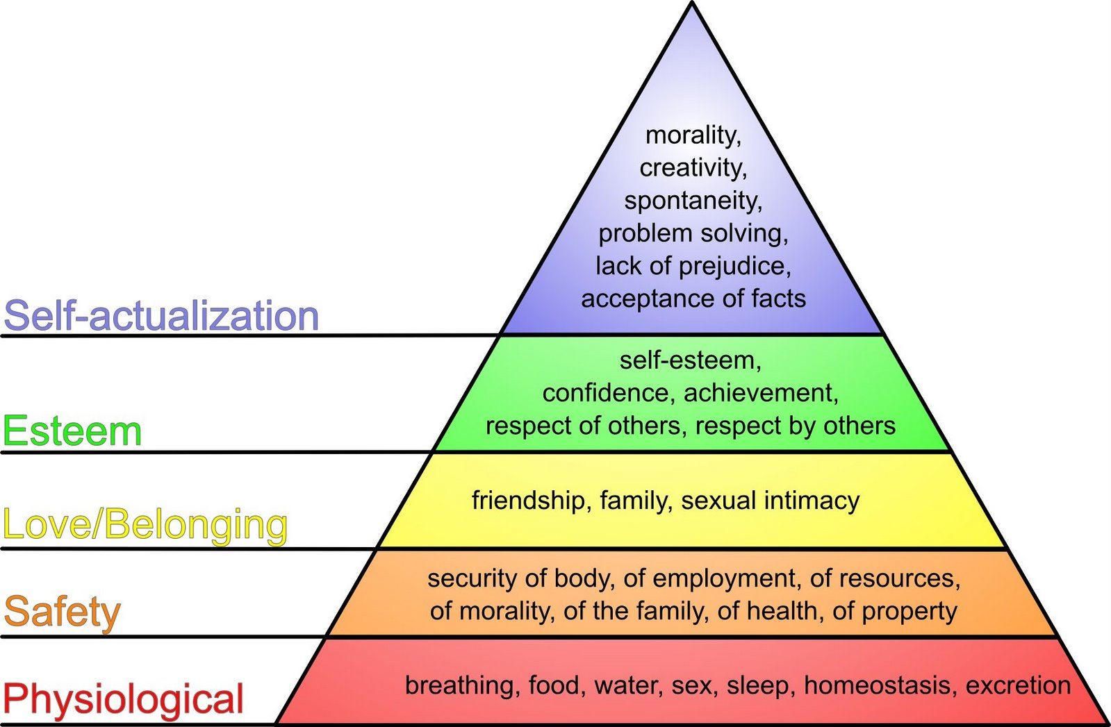

Slide 3
Communication about relationships
Content & Relational foci
  Physical
  Identity
  Social
  Practical goals

Slide 4
FIRO theory of needs
Fundamental interpersonal relations orientation (FIRO)
Need for
Need for
Need for

Slide 5
FIRO
NEED
Wants FROM Others
Expresses TO Others
Inclusion
Control
Affection

